Slide 1

IBM DATA SCIENCE CAPSTONE PROJECT
- Khushi Thakkar

Slide 2
INTRODUCTION
Aim: To analyse the accident “severity” in terms of human fatality, traffic delay, property damage, or any other type of accident bad impact.
Data: Collected by Seattle SPOT Traffic Management Division and provided by Coursera via a link. This dataset is updated weekly and is from 2004 to present. It contains information such as severity code, address type, location, collision type, weather, road condition, speeding, among others.
Target audiences: People who really care about the traffic records, especially in the transportation department. Also, we want to figure out the reason for collisions and help to reduce accidents in the future.

Slide 3
DATA
194,673 observations and 38 variables in this data set.
Since we would like to identify the factors that cause the accident and the level of severity, we will use SEVERITYCODE as our dependent variable Y, and try different combinations of independent variables X to get the result.
Since the observations are quite large, we may need to filter out the missing value and delete the unrelated columns first. Then we can select the factor which may have more impact on the accidents, such as address type, weather, road condition, and light condition. The target Data to be predicted under (SEVERITYCODE 1-prop damage 2-injury) label.
Other important variables include:
ADDRTYPE, LOCATION, PERSONCOUNT, VEHCOUNT, JUNCTIONTYPE, WEATHER, ROADCOND, LIGHTCOND, SPEEDING, SEGLANEKEY, ETC.

Slide 4
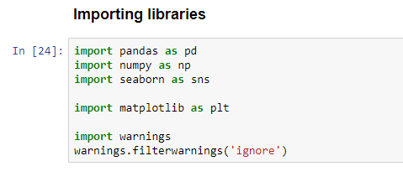
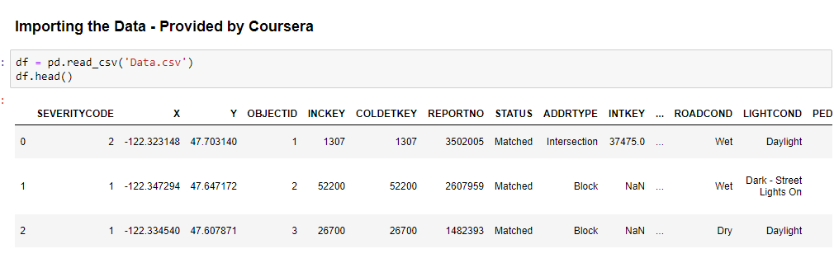
METHODOLOGY
We used Jupyter Notebook to do the data analysis. To generate the table and graph for the dataset, we imported Python libraries (Pandas, Numpy, Matplotlib, and Seaborn).

Slide 5
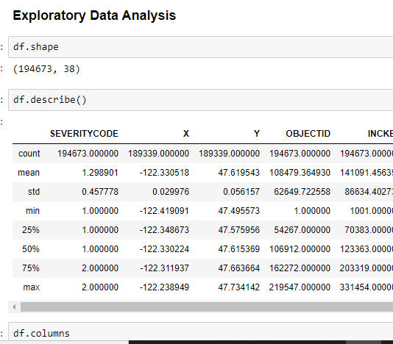
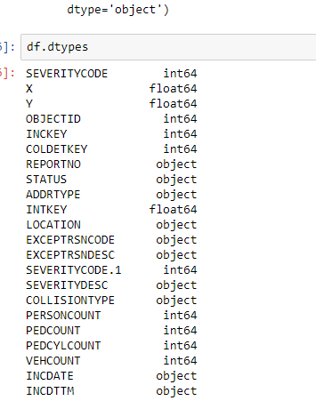
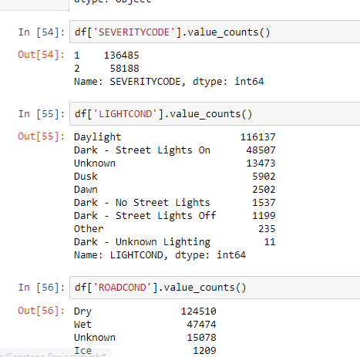
METHODOLOGY - EDA

Slide 6
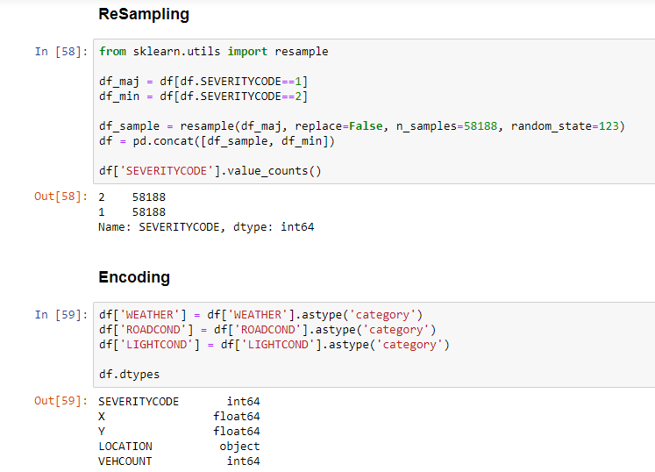
METHODOLOGY - RESAMPLING

Slide 7
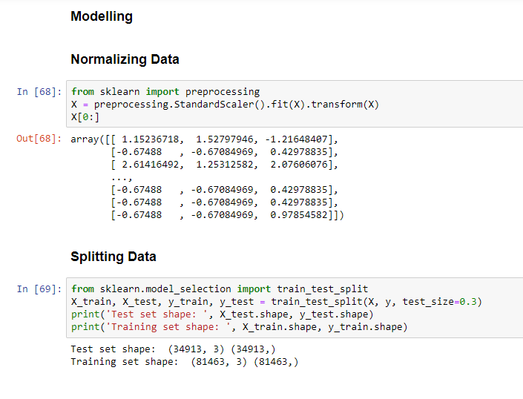
METHODOLOGY - MODELLING

Slide 8
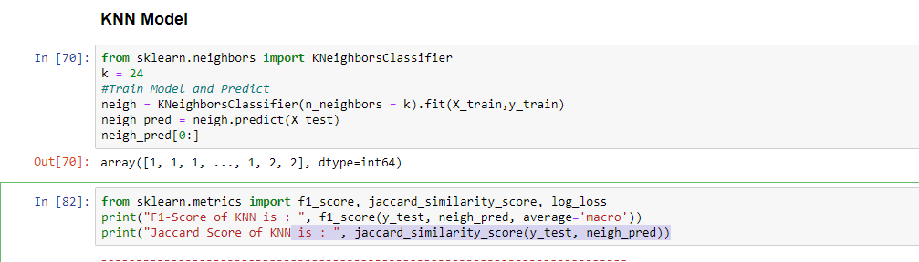
METHODOLOGY - KNN

Slide 9
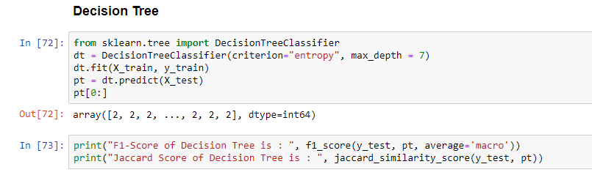
METHODOLOGY – DECISION TREE

Slide 10
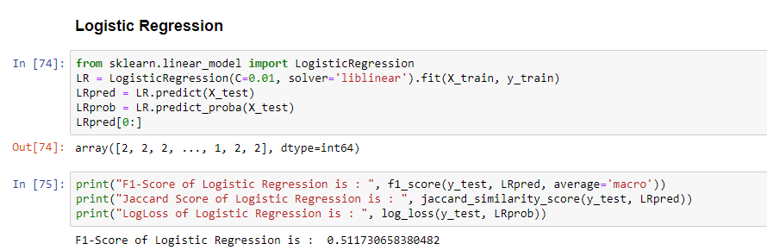
METHODOLOGY – LOGISTIC REGRESSION

Slide 11
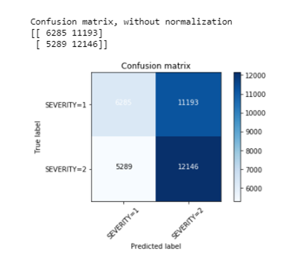
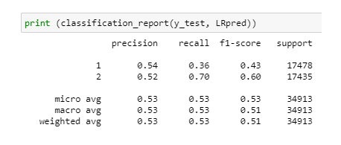
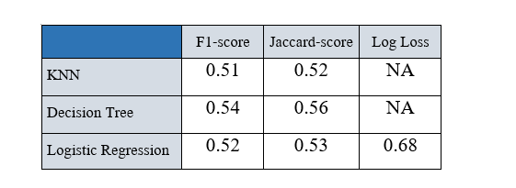
EVALUATION

Slide 12
CONCLUSION
Based on historical data from the collision in Seattle, we can conclude that particular weather, road and light conditions have an impact on whether or not the car ride could result in one of the two classes property damage (class 1) or injury (class 2).

